Slide 1


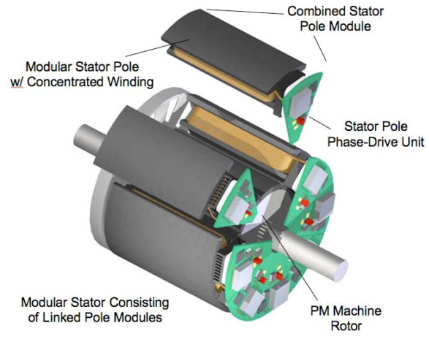
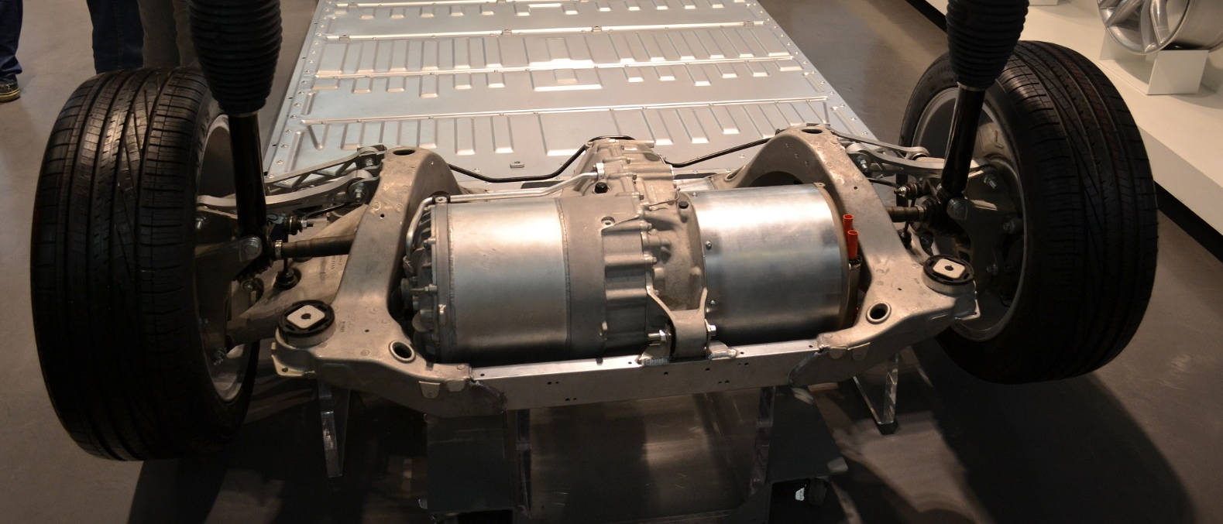
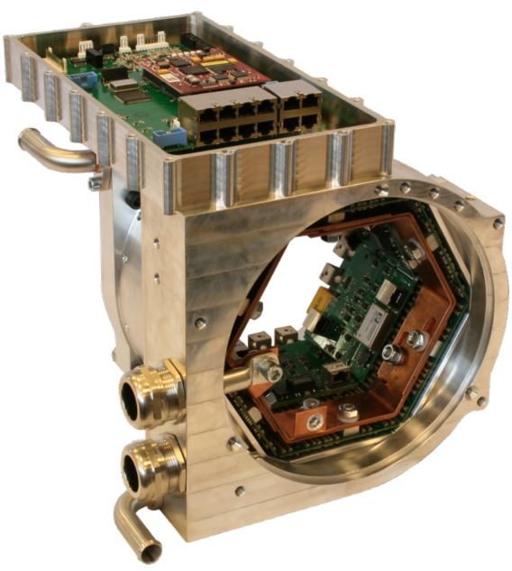
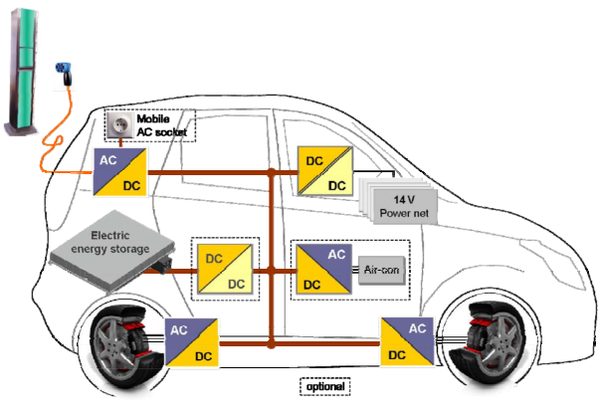
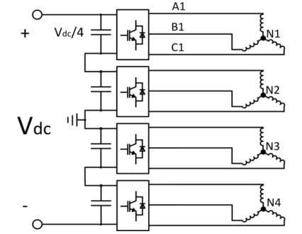
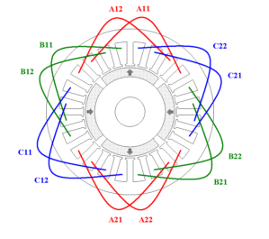
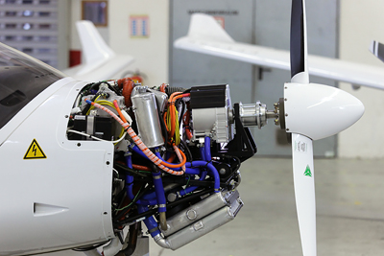
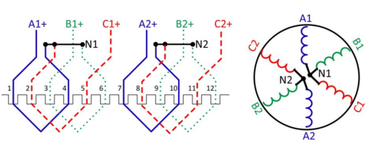
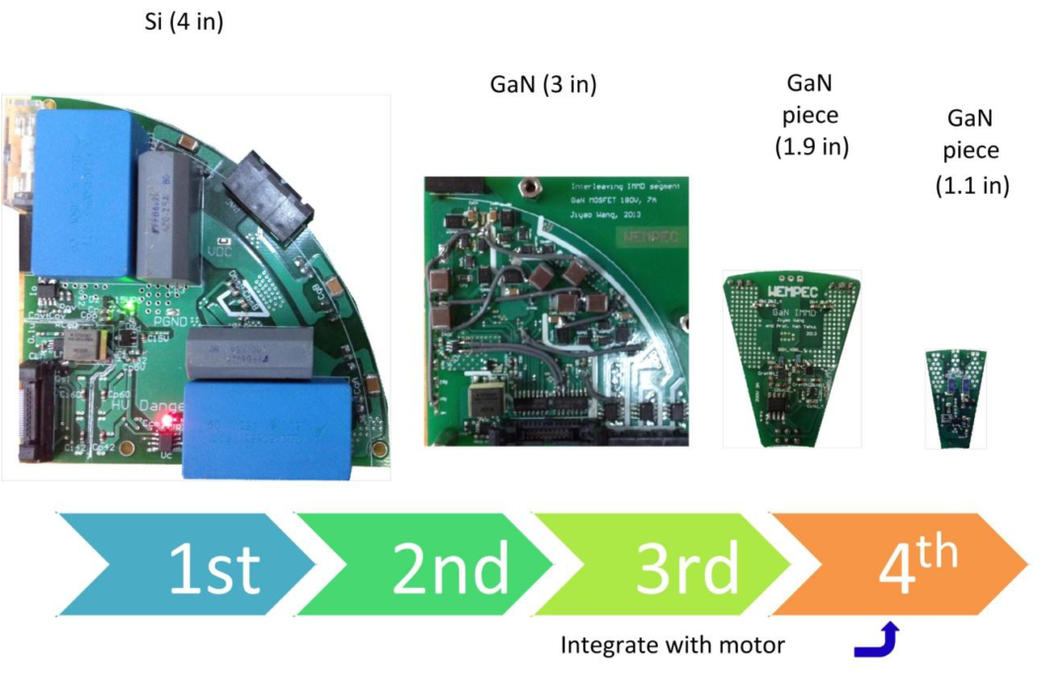
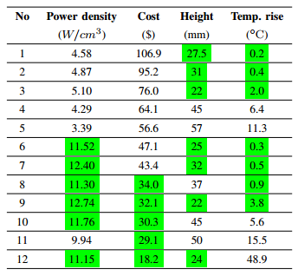
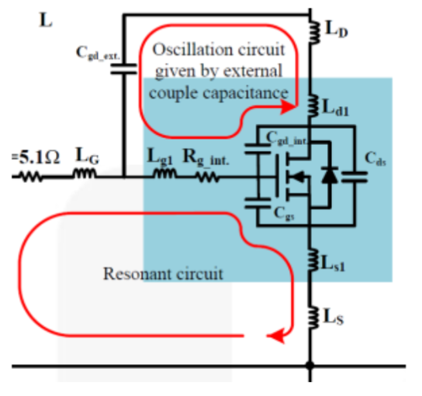
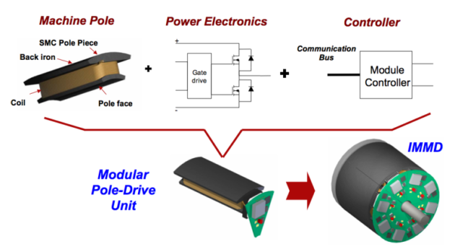
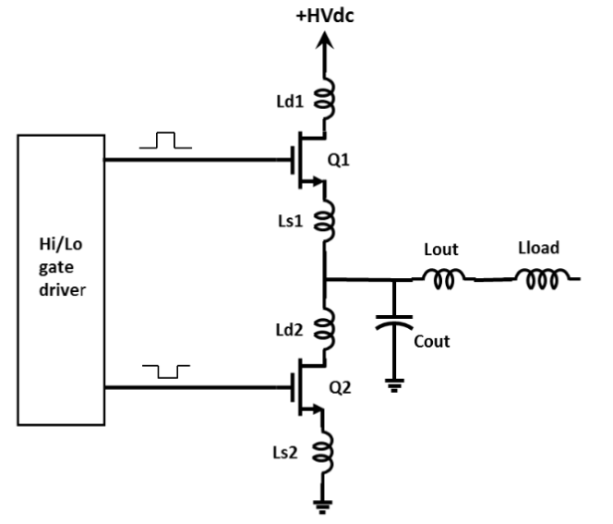
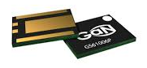
Development of an Integrated Modular Motor Drive (IMMD) System
Mesut Uğur Ozan Keysan
ugurm@metu.edu.tr keysan@metu.edu.tr
Department of Electrical and Electronics Engineering
Middle East Technical University
Large volume/cost
Model
Algorithm
Effect of Interleaving
Results
Introduction
DC link capacitor optimization
In conventional motor drive systems, drive units are placed in a separate cabinet, and they are connected to the motor via long cables. This brings increased volume and weight as well as increased voltage overshoot and electromagnetic interference (EMI) problems.
In integrated modular motor drives (IMMD), the motor drive is integrated directly to the motor back-end and the system is modularized by dividing into several parts.
DC link capacitors constitute 20% of cost and weight, and 30% of volume
An analytical model has been constructed. An algorithm has been developed. A set of film capacitors are considered. Optimization is achieved based on:
Power density
Cost
Height
Temperature rise
Effect of interleaving
Motivation
Phase-shift angle
Integration
Power density of the overall system is enhanced significantly.
Voltage overshoots due to cabling effect is eliminated.
Modularization
Fault tolerance is increased
Voltage stress on modules is reduced
Heat dissipation is distributed to a wider area
Applications
Electric traction: electric vehicles, trains
Aerospace: aircrafts, space crafts
IMMD Design
Proposed Topology
Fractional slot machines
Frameless motor
Modular PCB
GaN
Master/slave
Challenges
Fitting into a small volume requires size reduction and optimum placement of components.
Cooling of both units should be achieved simultaneously.
Power and control electronics components are subjected to high temperature and vibration
These challenges can be addressed by using wide band-gap (WBG) power semiconductor devices such as Gallium Nitride (GaN).
Low semiconductor loss: heat sink size is reduced
High operation frequency: passive component size is reduced
Conclusion
Here are my conclusions
Additional challenges
Parasitic components become significant
Careful layout design is required
References
EEE Graduate Research Workshop 2017

